Slide 1
RNS INSTITUTE OF TECHNOLOGY DEPARTMENT OF INFORMATION SCIENCE AND ENGINEERING DESIGN AND ANALYSIS OF ALGORITHMS LABORATORY(18CSL47) TITLE: 8 PUZZLE PROBLEM USING LEAST COST BRANCH AND BOUND
STAFF IN CHARGE : Mrs. Kusuma S Done by: M balakrishna kamath
Designation:

Slide 2
CONTENTS
ABSTRACT
INTRODUCTION
OBJECTIVE OF THE PROJECT
ALGORITHM DESIGN TECHNIQUE
PROJECT ARCHITECTURE
IMPLEMENTATION MODULES
RESULTS
Different algorithm techniques to solve 8 puzzle problem
APPLICATIONS
CONCLUSION AND FUTURE ENHANCEMENTS
REFERENCES

Slide 3
ABSTRACT
I have designed a code to solve 8 puzzle problem using least cost branch and brand algorithm.
I’m going to take you through the project layout wherein you will see the construction , objective ,purpose of the project…
Here’s the complete outlook of the project..

Slide 4
INTRODUCTION
The base layout is a 3 by 3 grid with 8 square blocks labeled from 1 to 8 and an empty square block at the end.
For a given jumbled sequence, the objective is to rearrange the blocks in such a way that it matches the base configuration given above.

Slide 5
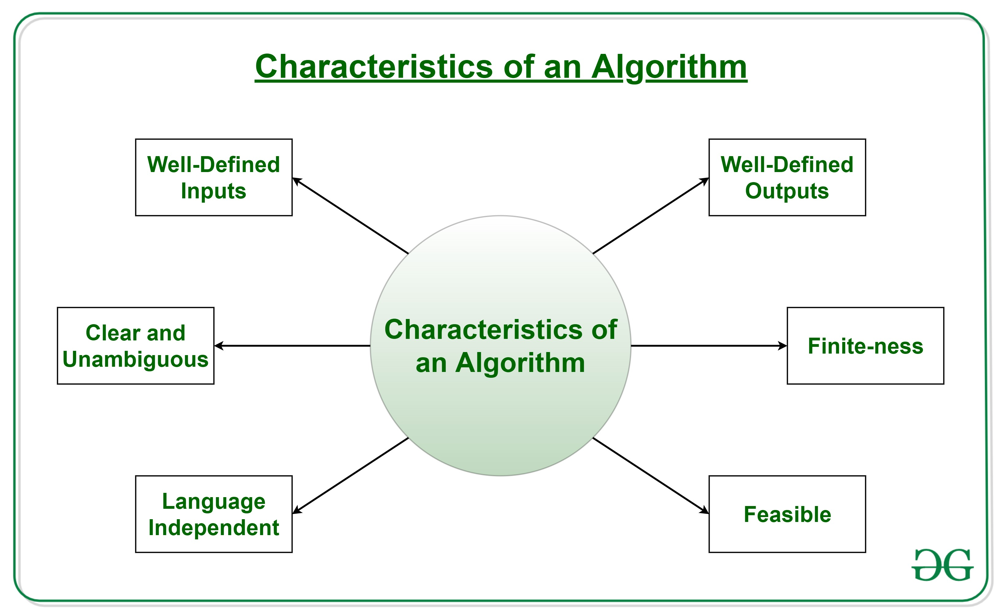
We use the least cost branch and bound technique to solve this problem.
Here, we create partial solutions of the possible moves and select the partial solution with the least amount of unordered blocks at each level of branching until the base configuration is achieved.

Slide 6
OBJECTIVE
The objective of this project is that it gives the sequence of steps needed to find the base configuration when a given jumbled sequence is given as a problem.
There maybe instances where there can be no solution to a given problem.
Least Cost Branch and Bound helps us achieve this by checking through the steps and finding a valid answer.

Slide 7
ALGORITHM DESIGN TECHNIQUE
The search for an answer node can often be speeded by using an “intelligent” ranking function, also called an approximate cost function to avoid searching in sub-trees that do not contain an answer node. It is similar to the backtracking technique but uses a BFS-like search.
The least cost Brand and Bound algorithm helps us delete the unwanted partial solutions created and select the best optimized solution at each level of state space tree.
We obtain the solution with the least number of steps and also obtain it quicker.

Slide 8
PROJECT ARCHITECTURE
There are basically three types of nodes involved in Branch and Bound 1. Live node is a node that has been generated but whose children have not yet been generated. 2. E-node is a live node whose children are currently being explored. In other words, an E-node is a node currently being expanded. 3. Dead node is a generated node that is not to be expanded or explored any further. All children of a dead node have already been expanded.
The ideal Cost function for an 8-puzzle Algorithm : We assume that moving one tile in any direction will have a 1 unit cost. Keeping that in mind, we define a cost function for the 8-puzzle algorithm as below:
c(x)=f(x)+h(x)
where f(x) is the length of the path from root to x(number of moves so far)
h(x) is the number of tiles that are not in their goal position(number of misplaced tiles)

Slide 9
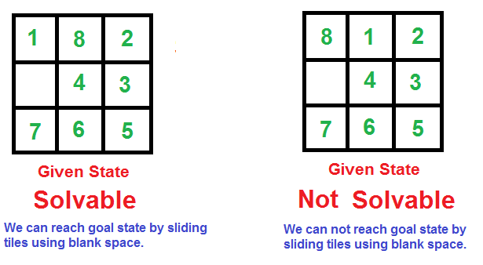
CHECKING FOR SOLVABILITY OF THE PUZZLE:
->Solvable input: ->Not Solvable:
1 has no inversion 8 has 7 inversions
8 has 6 inversions 1 has no inversions
2 has no inversion 2 has no inversions
4 has 1 inversion 4 has 1 inversion
3 has no inversion 3 has no inversions
7 has 2 inversions 7 has 2 inversions
6 has 1 inversion 6 has 1 inversion
5 has no inversions 5 has no inversions
TOTAL INVERSIONS=10 TOTAL INVERSIONS=11
A pair of tiles form an inversion if the values on tiles are in reverse order of their appearance in goal state.

Slide 10
COMPLETE ALGORITHM
/* Algorithm LCSearch uses c(x) to find an answer node
* LCSearch uses Least() and Add() to maintain the list
of live nodes
* Least() finds a live node with least c(x), deletes
it from the list and returns it
* Add(x) adds x to the list of live nodes
* Implement list of live nodes as a min-heap */
struct list_node
{
list_node *next;
// Helps in tracing path when answer is found
list_node *parent;
float cost;
}
algorithm LCSearch(list_node *t)
{
// Search t for an answer node
// Input: Root node of tree t
// Output: Path from answer node to root
if (*t is an answer node)
{
print(*t);
return;
}
E = t; // E-node
Initialize the list of live nodes to be empty;
while (true)
{
for each child x of E

Slide 11
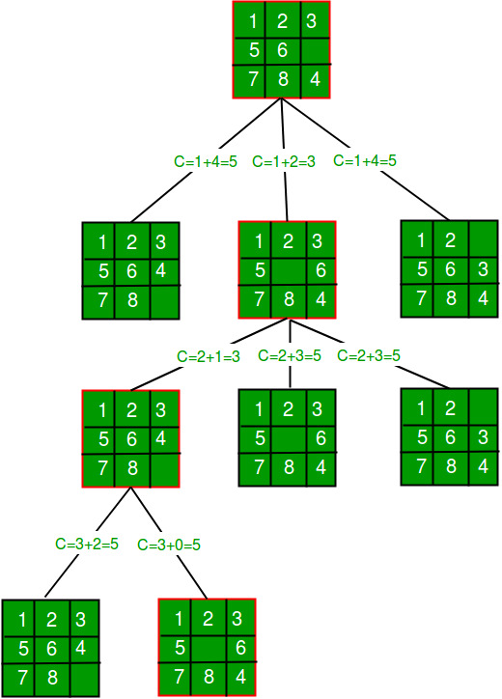
{
if x is an answer node
{
print the path from x to t;
return;
}
Add (x); // Add x to list of live nodes;
x->parent = E; // Pointer for path to root
}
if there are no more live nodes
{
print ("No answer node");
return;
}
// Find a live node with least estimated cost
E = Least();
// The found node is deleted from the list of
// live nodes
}
}
The state space tree shows the least cost branch and bound technique.
At each level, the node X with least cost is chosen as E-node and branching takes place at that node.

Slide 12
IMPLEMENTATION MODULES

Slide 13
MAIN FUNCTION: public static void main(String[] args) { int a=0,b=0; int[][] initial = new int[3][3]; int[][] goal = { {1, 2, 3}, {4, 5, 6}, {7, 8, 0} }; System.out.println("Enter the puzzle to be solved (Numbers from 0 to 8, where 0 is the blank tile):\n"); Scanner s= new Scanner(System.in); for(int i=0;i<3;i++) for(int j=0;j<3;j++) initial[i][j]=s.nextInt(); // White tile coordinate for(int i=0;i<3;i++) for(int j=0;j<3;j++) { if(initial[i][j]==0) { a=i; b=j; } } puzzle8 puzzle = new puzzle8(); if (puzzle.isSolvable(initial)) { puzzle.solve(initial, goal, a, b); } else { System.out.println("The given initial is impossible to solve"); }}
The main function takes the user input i.e, the initial scrambled matrix.
It checks if the the given puzzle is solvable or not.
If it’s solvable, then the main function implements all the functions to give the steps to solve the problem.

Slide 14
public Node(int[][] matrix, int x, int y, int newX, int newY, int level, Node parent) { // set pointer for path to root this.parent = parent; // copy data from parent node to current node this.matrix = new int[matrix.length][]; for (int i = 0; i < matrix.length; i++) { this.matrix[i] = matrix[i].clone(); } // Swap value // move tile by 1 position this.matrix[x][y] = this.matrix[x][y] + this.matrix[newX][newY]; this.matrix[newX][newY] = this.matrix[x][y] - this.matrix[newX][newY]; this.matrix[x][y] = this.matrix[x][y] - this.matrix[newX][newY]; // set number of misplaced tiles this.cost = Integer.MAX_VALUE; // set number of moves so far this.level = level; // update new blank tile coordinates this.x = newX; this.y = newY; }
This constructor of class Node helps in setting a pointer to the parent node when branching takes place at each level.
When branching occurs, a clone of the parent is created.
The tile co-ordinates of this matrix is modified according to the moves implemented.
Hence it updates the new tile co-ordinates.
It also sets the level of this node.

Slide 15
public int calculateCost(int[][] initial, int[][] goal) { int count = 0; int n = initial.length; for (int i = 0; i < n; i++) { for (int j = 0; j < n; j++) { if (initial[i][j] != 0 && initial[i][j] != goal[i][j]) { count++; } } } return count; } public boolean isSafe(int x, int y) { return (x >= 0 && x < dimension && y >= 0 && y < dimension); }
“calculateCost” is a function that calculates the number of misplaced tiles in the considered node .
“isSafe” is a Boolean function that tells if the tile co-ordinates of a node are valid or not.

Slide 16
public void printMatrix(int[][] matrix) { String result=""; String[] printThis= {"","","","","","","","",""}; int B[]= new int[9]; int temo=0,t; for(int i=0;i<matrix.length;i++) for(int j=0;j<matrix.length;j++) { t=matrix[i][j]; B[temo]=t; temo++; } for(int x=0;x<B.length;x++) { String insertString="| "; if(B[x]==0) insertString += " "; else insertString += B[x] +" "; printThis[x]=insertString; } result += " __________________________\n"+"| | | |\n"+printThis[0]+printThis[1]+printThis[2]+"|\n"+"|________|________|________|\n" +"| | | |\n"+printThis[3]+printThis[4]+printThis[5]+"|\n"+"|________|________|________|\n"+"| | | |\n"+ printThis[6]+printThis[7]+printThis[8]+"|\n"+"|________|________|________|\n\n"; System.out.println(result); }
This function prints each of the solution matrices from the initial input node to the goal node step by step(through each levels).
It prints the tile co-ordinates in such a way that it displays it inside a box with 3*3 tiles.

Slide 17
public void printPath(Node root) { if (root == null) { return; } printPath(root.parent); printMatrix(root.matrix); System.out.println(); } //To find if the initial matrix is solvable public boolean isSolvable(int[][] matrix) { int count = 0; List<Integer> array = new ArrayList<Integer>(); for (int i = 0; i < matrix.length; i++) { for (int j = 0; j < matrix.length; j++) { array.add(matrix[i][j]); } } Integer[] anotherArray = new Integer[array.size()]; array.toArray(anotherArray); for (int i = 0; i < anotherArray.length - 1; i++) { for (int j = i + 1; j < anotherArray.length; j++) { if (anotherArray[i] != 0 && anotherArray[j] != 0 && anotherArray[i] > anotherArray[j]) { count++; } } } return count % 2 == 0; }
“printPath” function recursively iterates from the goal node found to the initial node and prints all the solution nodes one by one in the order of their moves.
“isSolavble” function calculates the total number of inversions by setting up a counter. If the count is even, it’s a solvable puzzle else not solvable.

Slide 18
public void solve(int[][] initial, int[][] goal, int x, int y) { // Create a priority queue to store live nodes of search tree; PriorityQueue<Node> pq = new PriorityQueue<Node>(1000, (a, b) -> (a.cost + a.level) - (b.cost + b.level));//Lambda expn // create a root node and calculate its cost Node root = new Node(initial, x, y, x, y, 0, null); root.cost = calculateCost(initial, goal); // Add root to list of live nodes; pq.add(root); // Finds a live node with least cost, add its childrens to list of live nodes and // finally deletes it from the list. while (!pq.isEmpty()) { // Find a live node with least estimated cost // The found node is deleted from the list of live nodes Node min = pq.poll(); // if min is an answer node if (min.cost == 0) { // print the path from root to destination; printPath(min); return; } // do for each child of min // max 4 children for a node for (int i = 0; i < 4; i++) { if (isSafe(min.x + row[i], min.y + col[i])) { // create a child node and calculate its cost Node child = new Node(min.matrix, min.x, min.y, min.x + row[i], min.y + col[i], min.level + 1, min); child.cost = calculateCost(child.matrix, goal); // Add child to list of live nodes pq.add(child); } } }}
This function sets up a priority queue. Then a live node with least cost is found and it’s children are added to the list of live nodes and gradually deleted from the list.
This ultimately results in the goal node being found and then the “printPath” function is called to print the solution matrices step by step.
It also checks if the co-ordinates of the child node created are valid or not by calling the “isSafe” function.

Slide 19
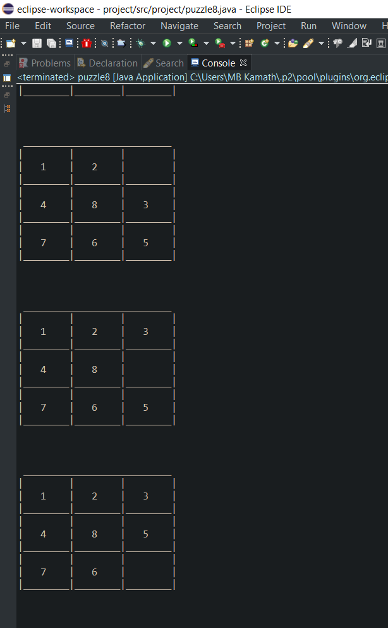
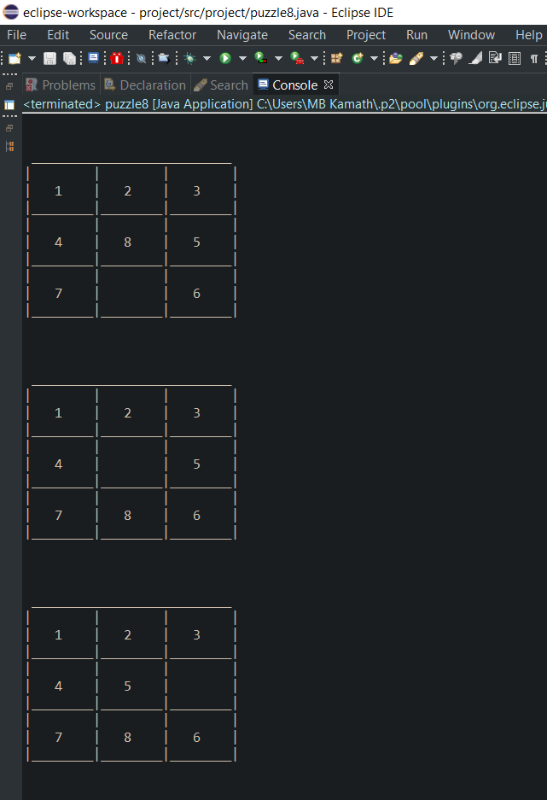
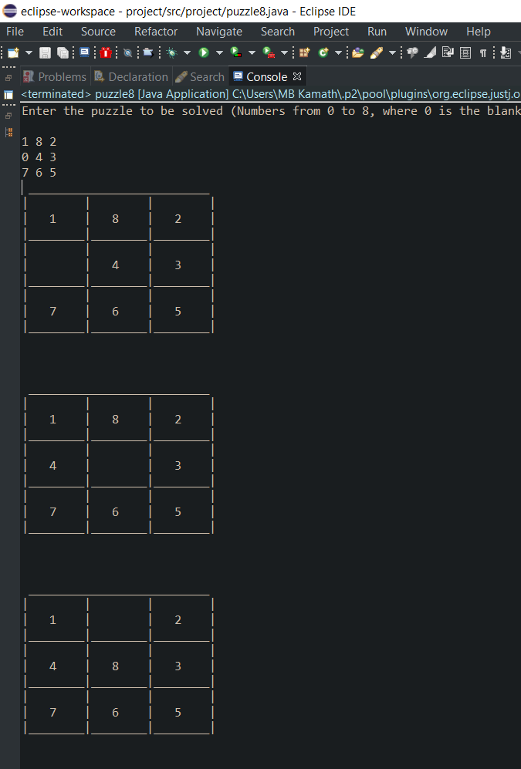
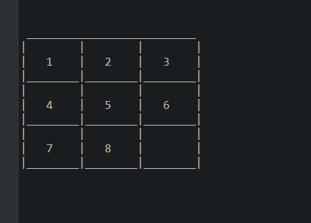
RESULT
(SOLVABLE)

Slide 20
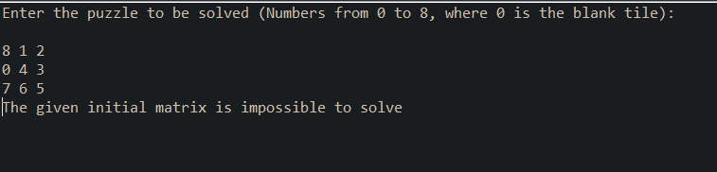
RESULT( NOT-SOLVABLE)

Slide 21
DIFFERENT ALGORITHM TECHNIQUES TO SOLVE 8 PUZZLE PROBLEM
FIFO and LIFO Branch and Bound techniques maybe used but they consumes more time and space.
DFS and BFS brute force
A* search technique
Heuristic (informed search) in AI

Slide 22
APPLICATIONS
Cutting stock problem
Maximum satisfiability problem
Nearest Neighbor search(road map)
Flow-shop scheduling
Machine learning and AI

Slide 23
CONCLUSION AND FUTURE ENHANCEMENTS
This technique can be used to find the shortest sequence to find the base configuration.
Keeping this in mind we can always enhance the software to make it better by bringing out updates.
Visual appeal is a key to the user. We can use graphical interfaces to make visually attractive.
Likewise we can bring many more modifications to make the code faster by using AI , etc…
Creating such projects help the developers to learn new things and enhance their knowledge and broaden their perspective on how software systems work. We can only get better with experience.

Slide 24
REFERENCES
DAA textbooks
Google for images
8 puzzle Problem using Branch And Bound – GeeksforGeeks

